Slide 1
Movie Review SENTIMENTAL ANALYSIS
Drashti Khatra (11053803)
Sahil Patel (11045739)

Slide 2
objective
Objective: Develop an effective sentiment analysis model using RapidMiner
Compare two models with different parameter settings
Identify the configuration with the highest accuracy

Slide 3
Data collection
Dataset: Stanford Large Movie Review Dataset
50,000 movie reviews (25,000 training, 25,000 testing)
Balanced dataset: 500 positive and 500 negative reviews randomly selected from the training set
Total of 1,000 labeled text files

Slide 4
Methodology
1. Data Processing:
Process Documents from Files' operator: TF-IDF word vectors, percentual pruning
2. Data Splitting:
Cross Validation' operator: 10 folds, automatic sampling, parallel execution
3. Sentiment Classification Models:
Model 1: k-NN (k=5, cosine similarity)
Model 2: k-NN (k=10, Euclidean distance)
4. Performance Evaluation:
Performance (Classification) operator

Slide 5
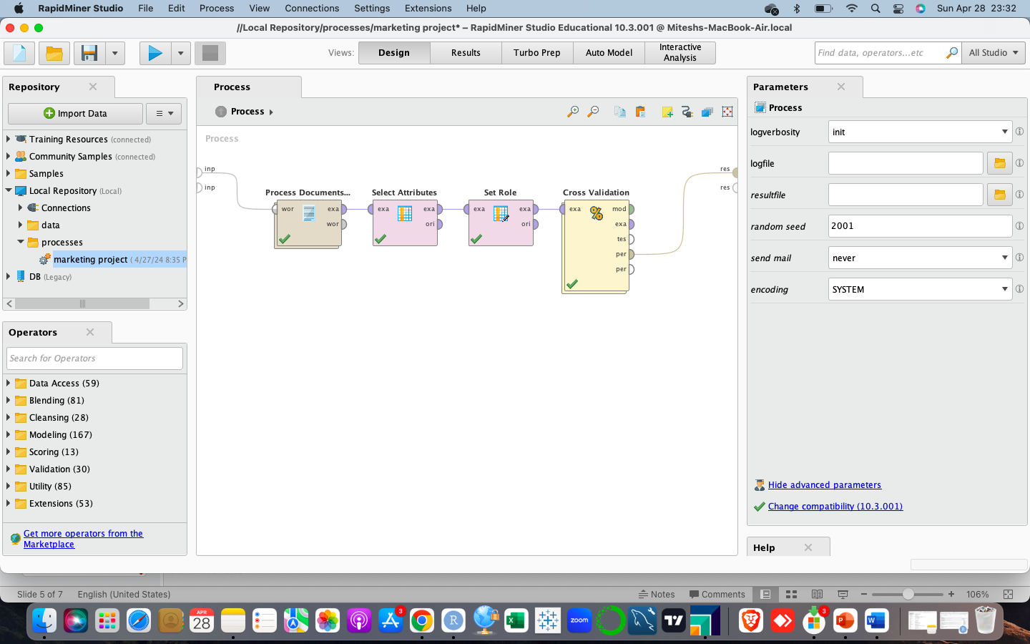
Model

Slide 6
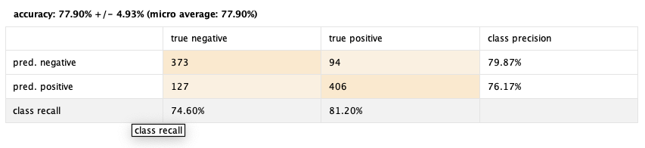
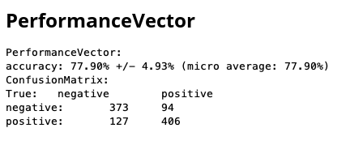
Model1 results

Slide 7
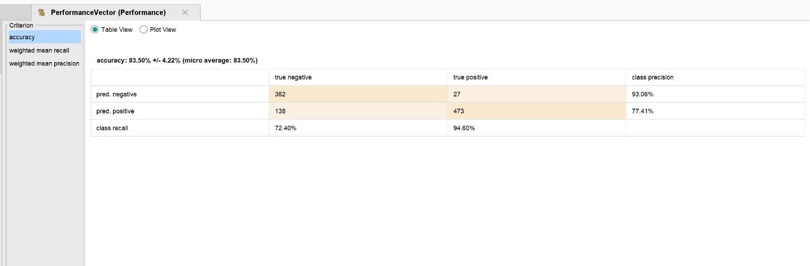
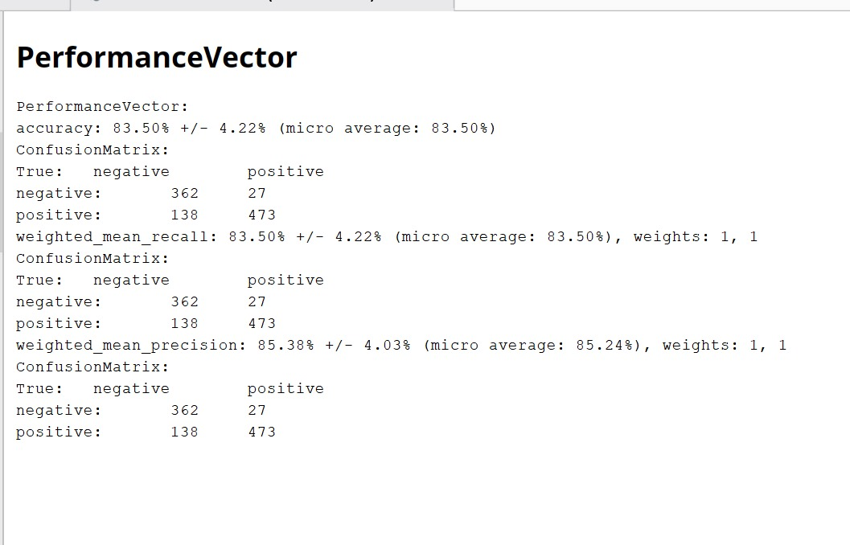
Model2 results

Slide 8
conclusion
Successful development of sentiment analysis models using RapidMiner
Model 2 (optimized parameters) achieved 83.50% accuracy
Significance of sentiment analysis for marketing professionals
Sentiment analysis: a powerful tool for understanding customer sentiment

Slide 9
Thank you!

